Slide 1
UE20CS390A – Project Phase – 1
End Semester Assessment
Project Title : PAYCRYPTO: A Fintech Application for the
Currency of Future
Project ID : 127
Project Guide : Prof. Gauri Sameer Rapate
Project Team : 1) Aryansh Garg
2) Harsh agrawal
3) Harshit sharma
4) Sagarikha M.

Slide 2
Agenda
Introduction and Motivation
Problem Statement
Abstract and Scope
Literature Survey / Existing System
Suggestions from Review – 3
Requirements Specification
Design Approach
Design Constraints, Assumptions & Dependencies
Proposed System / Approach
Architecture
Design Description
Project Progress
References

Slide 3
Introduction and Motivation
PAYCRYPTO is a coming of age fintech application developed specifically for cryptocurrencies.
The rapidly increasing demand of cryptocurrencies in the market and the buzz among the masses has created a need for a platform which can act as one-stop solution for the cryptocurrencies.
In this application, a user will be able to invest in cryptocurrency of their choice among the listed one and also can make per-to-peer transactions.
Since cryptocurrency is very volatile, to counter it price prediction feature will be introduced where users can get to know the price forecast and can make informed decisions about their investment strategies.
A user- friendly platform which can be used by anyone who wants to enter the world of cryptocurrency is the main goal of PAYCRYPTO.

Slide 4
Problem Statement
The rapidly increasing popularity and buzz of this new technology based currency, called as cryptocurrency, has sparked curiosity among the masses to get their hands on this modern currency.
Every other individual desires to experience this new currency to remain in the mainstream market
People who understands the technology working behind it knows the benefits of using this currency very well.
What if there was a platform that people can use to enter in this new world of cryptocurrency?
Surprisingly no such platform exist which is easy enough to be used by any individual whether he/she is well versed in technology or not.
PAYCRYPTO is such a platform which makes cryptocurrency easy to use.

Slide 5
Problem Statement
What can be done with a currency(money)?
- It can be used for transaction
- It can be invested in different mechanisms to multiply it.
Since the beginning of time, it has been done with traditional currency but PAYCRYPTO makes it possible to do it with cryptocurrency as well.
It lets users make transactions to other users in the form of cryptocurrency
As cryptocurrency is a new deal in the market, it is very volatile in nature and makes it difficult for users to invest profitably but PAYCRYPTO has the solution for this problem too. The price prediction feature of it can give users the idea of the prices of the currency beforehand and one can invest accordingly to be in the profit side at the end of the day.

Slide 6
Scope
PAYCRYPTO can be used by anyone who wants to make transactions in cryptocurrency to other users or businesses as well as who wants to invest in different cryptocurrencies to gain profits.
To increase its user base, one of the major factor is user-friendly interface.
Curiosity among people towards the cryptocurrency is major advantage for the PAYCRYPTO to capture a wide user base.

Slide 7
Literature Survey/Existing System
DL-GuesS: Deep Learning and Sentiment Analysis-Based Cryptocurrency Price Prediction
The paper proposed a machine learning model which is named as DL-GuesS to forecast the cryptocurrency prices using historical data and twitter sentiment analysis. The proposed model tries to bring in new features which have not been implemented yet to improve the accuracy of the prediction model.

Slide 8
Literature Survey/Existing System
Advantages:
The proposed model in the above paper takes into account the inter-dependencies of different cryptocurrencies for the price prediction.
As the variation in prices of one currency can affect the prices of other currencies as well, this factor has been included as feature in the proposed model
Limitations:
Including inter-dependencies of a lot of currencies may not be that beneficial as only the popular currencies have an effect on the prices of other currencies.
Using a lot of features for predicting prices can lead to bad accuracy as a lot of features are there which do not have significant contribution in the prices.

Slide 9
Literature Survey/Existing System
A Research On Bitcoin Price Prediction Using Machine Learning Algorithms
This paper analyzes the historical price data of Bitcoin and identifies patterns and trends that can be used to predict future prices. This paper assesses the algorithms and provides the difference in each of their prediction accuracy and error rates. The authors also review what factors affect the efficiency and accuracy of the models, for instance, the input variables and the size of the training data set.

Slide 10
Literature Survey/Existing System
Advantages
The paper evaluates the performance of four machine learning algorithms.
Sensitivity analysis is performed allowing readers to understand which variables are most important for prediction.
The authors provide open-source code for their machine learning models.
Limitations
Only a few basic input features are used to train their machine learning models, which may not capture all the complex factors that influence Bitcoin prices.
They have used a relatively small dataset of Bitcoin prices.
The paper does not introduce any new techniques or methods for Bitcoin price prediction

Slide 11
Literature Survey/Existing System
Multivariate Cryptocurrency Prediction: comparative analysis of three recurrent neural networks approaches
The paper explores the use of recurrent neural networks (RNNs) for predicting cryptocurrency prices. They implement three RNN approaches (LSTM, GRU, and ESN) and compare their performance using data on various cryptocurrencies. The authors provide understanding into the potential of RNNs for cryptocurrency price prediction.

Slide 12
Literature Survey/Existing System
Advantages
The paper addresses a relevant and relatively new topic, namely the use of RNN models for predicting cryptocurrency prices.
The paper compares the performance of three different RNN models, which allows for a more thorough evaluation of their strengths and weaknesses.
The paper uses a multivariate time series dataset, this allows for a more comprehensive analysis of the factors that may affect cryptocurrency prices.
Limitations
Limited evaluation metrics.
The paper compares the performance of three RNN models, but does not compare them with other popular methods for cryptocurrency price prediction.
The dataset used in the paper covers a relatively short time period (from January 2017 to February 2018) and may not be representative of the long-term behavior of cryptocurrency prices.

Slide 13
Literature Survey/Existing System
Predicting Price of Cryptocurrency - A Deep Learning Approach
Objective of the paper:
This academic article's goal is to demonstrate and evaluate a cutting-edge method for using deep learning algorithms to forecast cryptocurrency values. Since cryptocurrencies are notorious for their extreme volatility and the shortcomings of conventional approaches to address the difficulties of predicting the future prices of cryptocurrencies.
Advantages:
It emphasises the benefits of utilising deep learning methods to estimate cryptocurrency values, including increased pattern detection, real-time flexibility, forecasting accuracy, and the possibility to forecast prices of other cryptocurrencies.

Slide 14
Literature Survey/Existing System
Limitations:
The paper does not cover Limited Generalizability in which it's possible that the deep learning models created for forecasting Bitcoin prices won't work for other cryptocurrencies. The price dynamics of each cryptocurrency may be unique, therefore the models created for Bitcoin may not be accurate for other cryptocurrencies.

Slide 15
Literature Survey/Existing System
Cryptocurrency Price Prediction using Long Short-Term Memory and Twitter Sentiment Analysis
Objective of the paper:
The article explores the use of machine learning and sentiment analysis to forecast the direction of the cryptocurrency market, particularly for Bitcoin. The authors use a deep neural network model called Long Short-Term Memory (LSTM) to analyze historical Bitcoin prices and Twitter data to predict future cryptocurrency prices. They also develop a dashboard prototype to assist investors in making investment decisions based on the predicted prices and the latest cryptocurrency updates. The paper highlights the value of integrating LSTM and sentiment analysis to forecast cryptocurrency prices accurately and provides a promising approach for future research in this field.

Slide 16
Literature Survey/Existing System
Advantage: The use of LSTM and sentiment analysis provides a highly accurate method for predicting cryptocurrency prices, which can help investors make more informed decisions.The paper integrates historical price data with Twitter sentiment data to provide a more comprehensive understanding of cryptocurrency price fluctuations, which can help investors gain a better perspective on market trends.
Limitations: Limited Scope: The paper focuses only on Bitcoin and may not be applicable to other cryptocurrencies, which could limit its usefulness for investors who are interested in other digital currencies.
Lack of Long-Term Predictions: The paper focuses on short-term predictions (3-4 days in advance) and does not provide insights into long-term trends or fluctuations in the cryptocurrency market.

Slide 17
Suggestions from Review - 3
ER diagram should be more detailed with proper indication of entities and their relations
High level structure diagram should contain both the aspects of the applications i.e transaction as well as price prediction.

Slide 18
Requirements/Technologies used
Requirements :
Crypto Price Prediction - The application will provide users with the ability to predict the prices of different cryptocurrencies using machine learning.The machine learning model will be trained on historical cryptocurrency price data and will use this data to make predictions about future price movements.The application will allow users to select the cryptocurrencies they are interested in and will provide them with predictions of the future prices of those cryptocurrencies.
Wallet Creation - The application will allow users to create a wallet to store their cryptocurrencies.The wallet will be secure and will use industry-standard encryption techniques to protect users' private keys.Users will be able to create multiple wallets for different cryptocurrencies.

Slide 19
Requirements/Technologies used
Buying and Trading Crypto - The application will allow users to buy and trade cryptocurrencies using their wallets.Users will be able to purchase cryptocurrencies using fiat currency or other cryptocurrencies.The application will also provide users with a trading platform where they can buy and sell cryptocurrencies based on the predicted prices.
Peer-to-Peer Crypto Transfers - The application will allow users to transfer cryptocurrencies to other users using QR codes or wallet details.The transfers will be secure and will use blockchain technology to ensure that the transactions are recorded on the blockchain.

Slide 20
Requirements/Technologies used
Technologies used:
Front-end technologies : HTML , CSS , JAVASCRIPT , REACTJS
Machine Learning : Python , TensorFlow , Jupyter NoteBook
APIs : Twitter Api for sentiment analysis , CoinApi for realtime and historical data of crypto currency
Blockchain : Ethereum blockchain , Metamask , Solidity
Backend Technologies : Nodejs , Expressjs
Database : MongoDB

Slide 21
Design Details
Novelty and innovativeness
The price prediction can be done with multiple machine learning models and each model has some different accuracy of the prediction. The proposed model for PAYCRYPTO uses historical data of the prices along with sentiment analysis from the social media to predict the prices.
With the hybrid model of deep learning algorithms like LSTM and GRU along with sentiment analysis, better accuracy can be achieved in predicting the future prices of cryptocurrencies.

Slide 22
Design Details
Interoperability
The platform should be operable on different devices so that more and more sample space of the users can be captured.
Performance
It should be able to predict with sufficient accuracy in minimum amount of time even at the times of huge traffic.
Security
The platform should be secure enough so that no ill practices can be performed by users which can harm other users.

Slide 23
Design Details
Reliability
The platform should be accurate and secure to build the trust among the users towards it
Maintainability
With regular updates of the interface and bug fixes(if any) the platform can be made more and more refined and user friendly
Legacy to modernization
New and advanced features can be added over time to make it useful in wide variety of situations, for example generating personalised QR code for each user to make transactions, etc.

Slide 24
Proposed System / Approach
Basic approach
The project is divided basically into two major parts
The cryptocurrency trading with price prediction
Peer to peer cryptocurrency transactions
For the first part, a machine learning model will be developed with historical data and social media sentiment analysis to predict the prices of different currencies.
Sentiment analysis is being used along with historical data to bring in the fact that many influential personalities can affect the prices through their opinions and views towards the crypto market on social media.

Slide 25
Proposed System / Approach
After the literature survey on the similar problem statements, a promising approach coming forward is using deep learning algorithm such as LSTM and GRU along with sentiment analysis using polarity extractor VADER which classifies the tweets under positive, negative or neutral.
For the transactions part, a wallet will be created to hold the currency and the user will be able to transfer the desired amount to other user after entering the PIN.

Slide 26
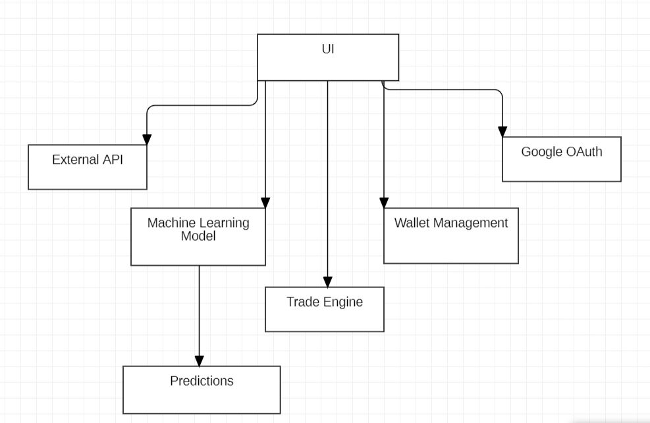
Design Description (if applicable)
UI DIAGRAM

Slide 27
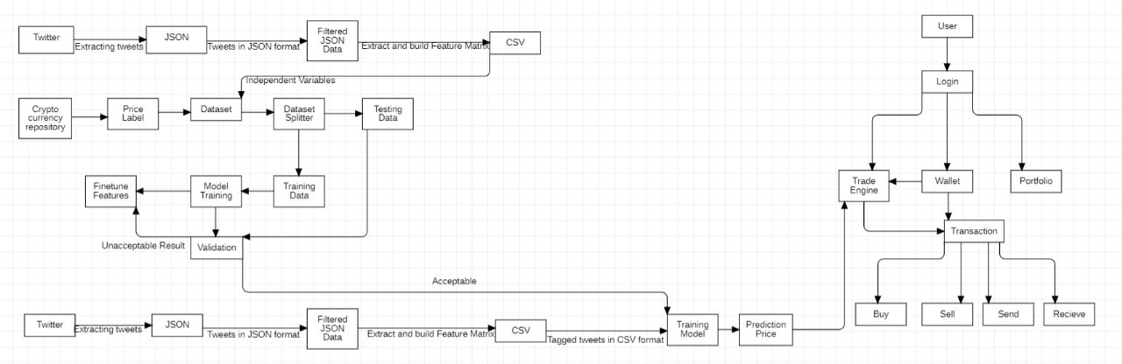
Architecture
HIGH LEVEL DESIGN STRUCTURE

Slide 28
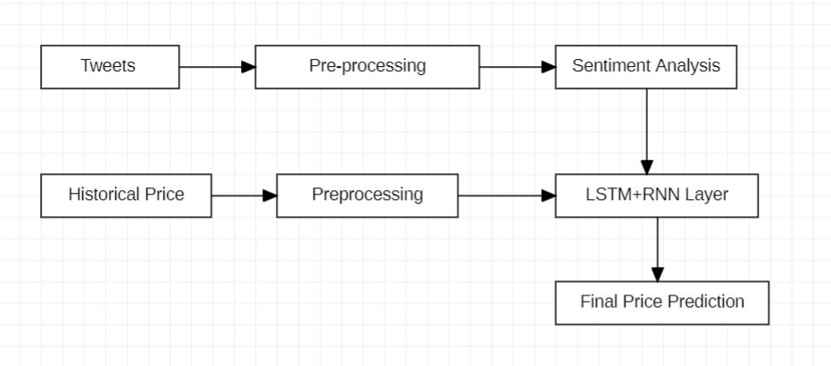
Design Description (if applicable)
Model overview

Slide 29
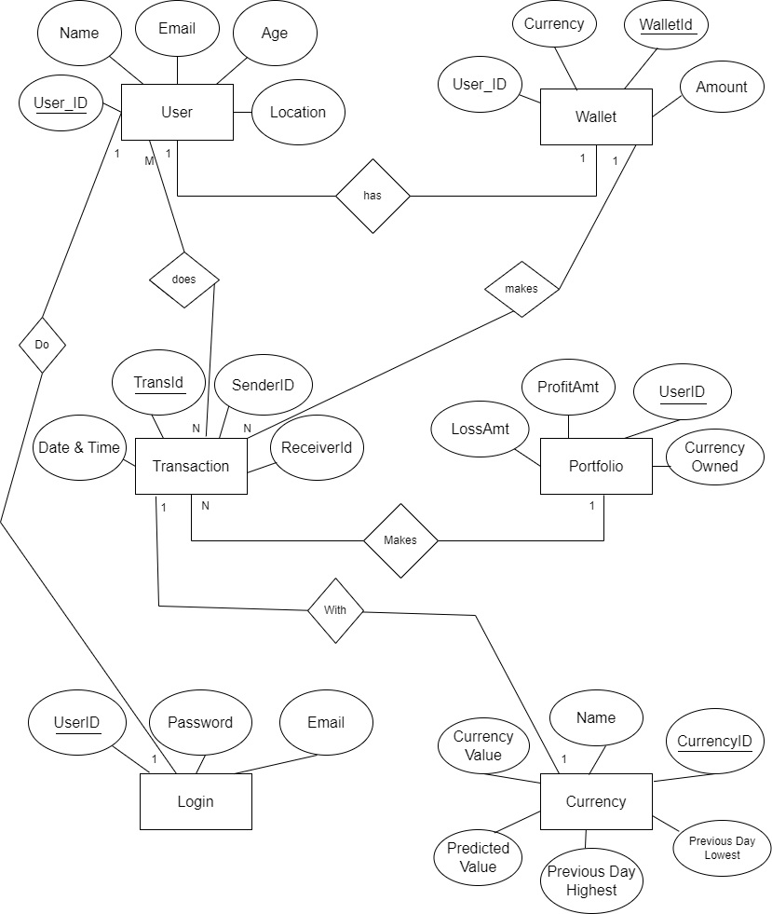
ER Diagram

Slide 30
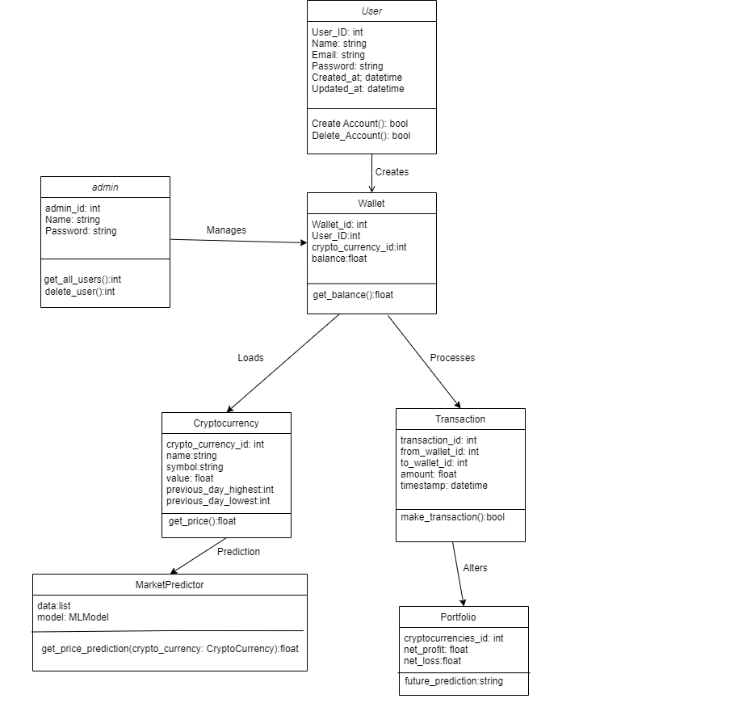
Design Description (if applicable)

Slide 31
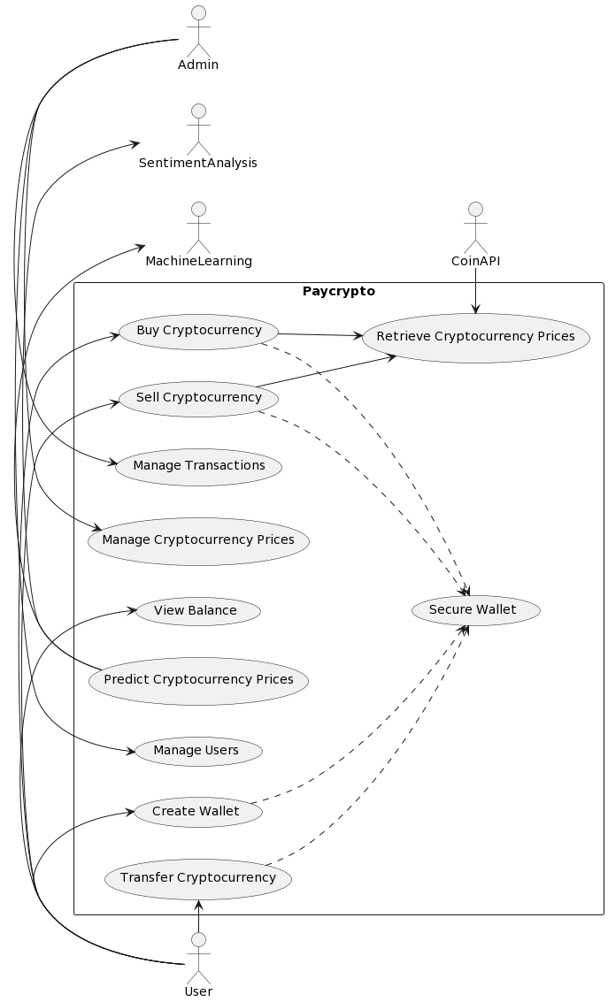
Design Description (if applicable)
use case

Slide 32
Project Progress
The majority of the designing, dataset validation, high level design, system architecture,System Architecture Specifications and project portions that needed to be finished for the project's implementation part were accomplished in phase 1 of the Capstone Project. For the features, the necessary literature surveys have been completed

Slide 33

Project Timeline

Slide 34
Conclusion
The main aim of PAYCRYPTO is to make cryptocurrency as accessible as UPI by providing a one stop solution for the cryptocurrency
Providing a fast and user friendly interface which can be used by anyone to make transactions as well as invest in currency of their choice is the target of PAYCRYPTO.
It provides price prediction feature to keep a check on the volatility of the crypto market so that people can plan their investments accordingly
Since the dataset of historical prices of cryptocurrency is relatively small, sentiment analysis is included into the price prediction model to obtain better accuracy.

Slide 35
References
R. Parekh et al.: DL-GuesS: Deep Learning and Sentiment Analysis-Based Cryptocurrency Price Prediction
Lekkala Sreekanth Reddy, Dr.P. Sriramya: A Research On Bitcoin Price Prediction Using Machine Learning Algorithms
Andrei-Alexandru Encean,Daniel Zinca : Cryptocurrency Price Prediction Using LSTM and GRU Networks
Seng Hansun , Arya Wicaksana and Abdul Q. M. Khaliq: Multivariate cryptocurrency prediction: comparative analysis of three recurrent neural networks approaches

Slide 36
Thank You

